Slide 1

MUSIC LIBRARY
MANAGEMENT
BY…..
Technocrats...

Slide 2
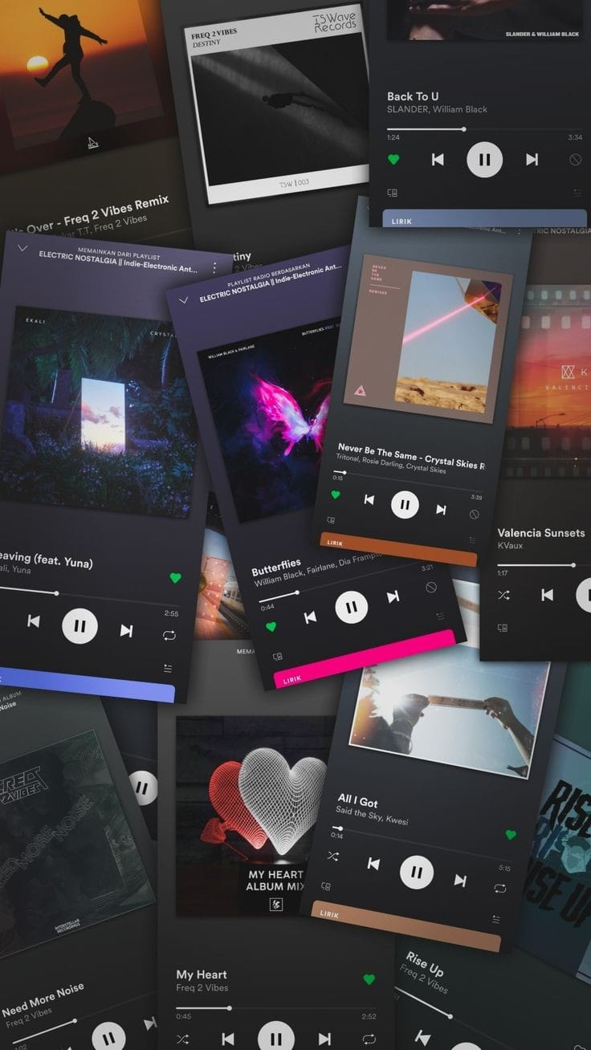
INTRODUCTION:
In the digital age, music enthusiasts often find themselves accumulating vast collections of audio files across various genres, artists, and albums. To streamline the organization and accessibility of these music libraries, a dedicated Music Library Management system becomes essential. This project aims to deliver an intuitive and feature-rich application built on JavaFX and designed with SceneBuilder to provide users with a seamless experience in managing their music collections.

Slide 3

TOOLS USED
HERE

Slide 4
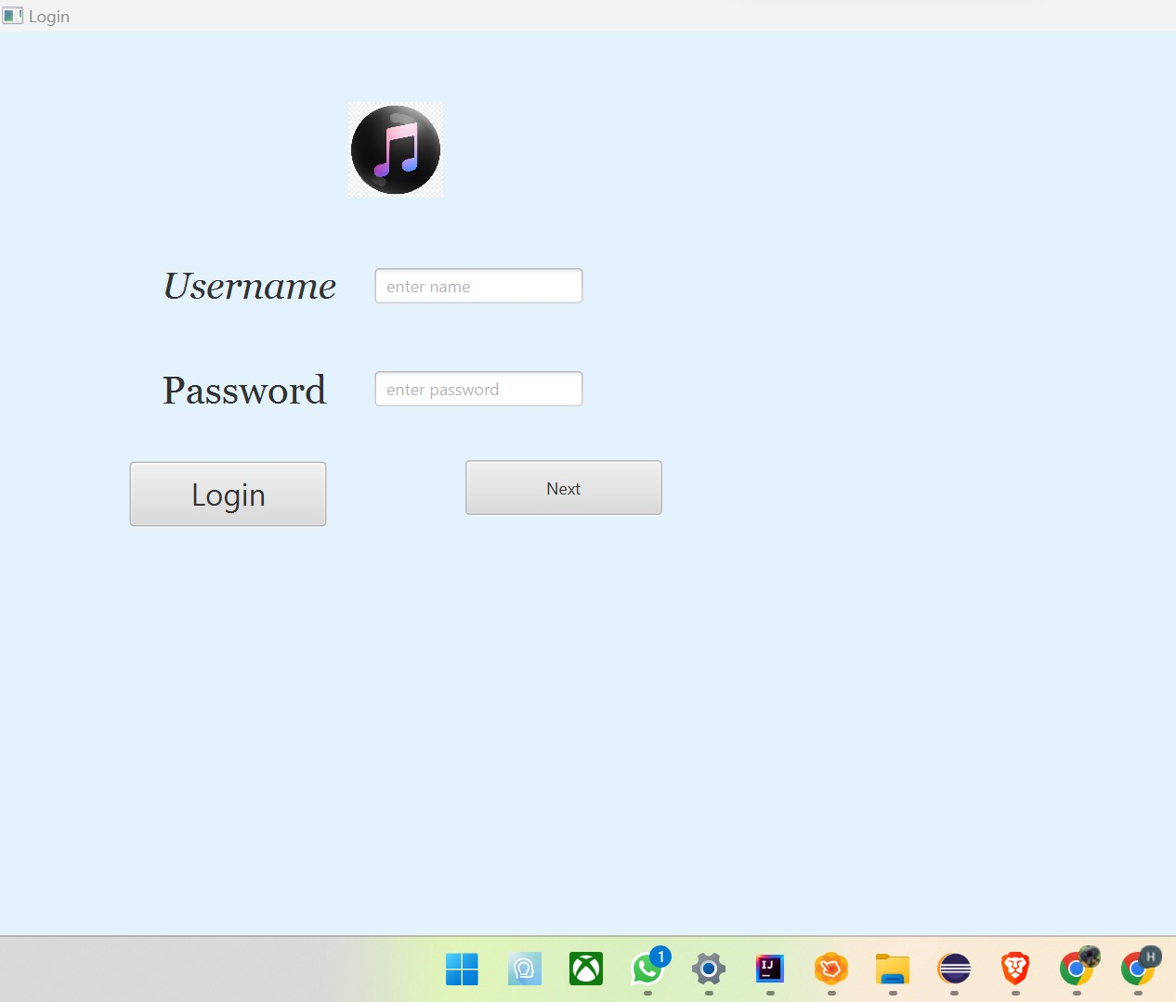
Workflow with IntelliJ IDEA and SceneBuilder:
Create Project: Start by creating a new JavaFX project in IntelliJ IDE.
FXML Files: Define the structure of your user interface using FXML files.
Open in SceneBuilder: Open the FXML files in SceneBuilder directly from IntelliJ IDEA.
Visual Design: Design the user interface visually by adding components and adjusting their properties.

Slide 5
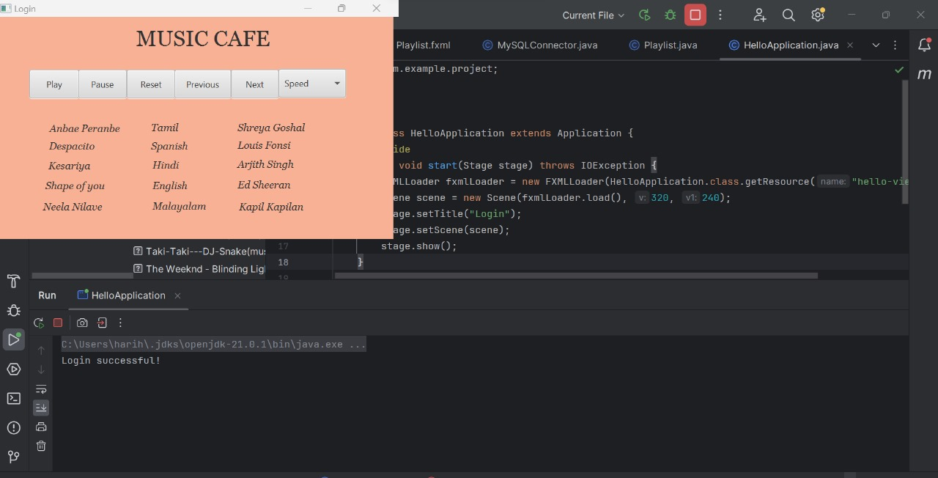
WORKING MODEL:
1. Login Page:
Functionality:
User Authentication: Validate user credentials against a predefined list or a database.
Error Handling: Display appropriate error messages for invalid credentials.
Implementation:
FXML Layout (login.fxml): Design the login form using SceneBuilder with fields for username, password, and a login button.
Controller (LoginController.java): Handle user input, validate credentials, and navigate to the music player page upon successful login.

Slide 6
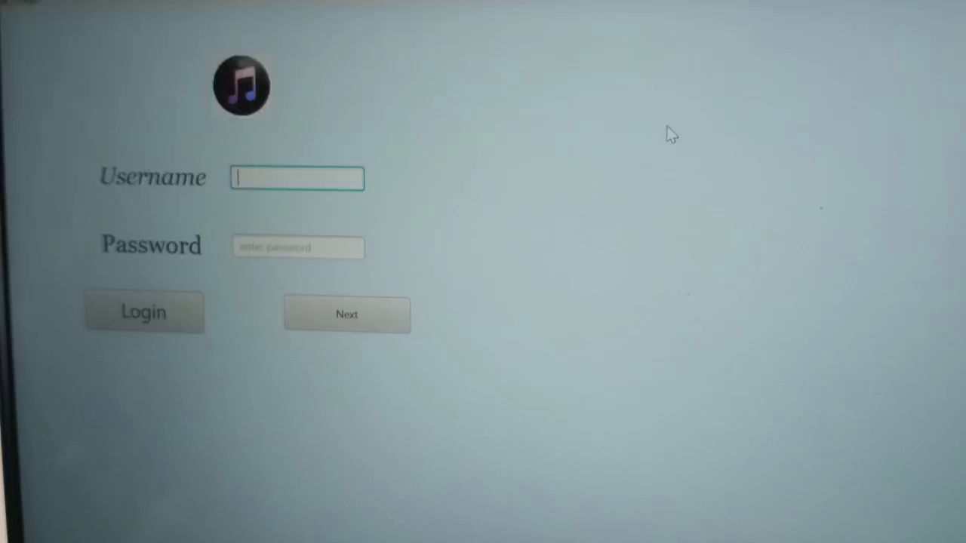
2. Music Player Page:
Functionality:
Playlist Display: Show a list of songs or playlists.
Audio Player Integration: Integrate an audio player to play selected songs.
Logout Option: Allow users to log out and return to the login page.
Implementation:
FXML Layout (musicPlayer.fxml): Design the music player page with a playlist view, play/pause buttons, and a logout button.
Controller (MusicPlayer.java): Implement logic to load and display playlists, play songs.

Slide 7
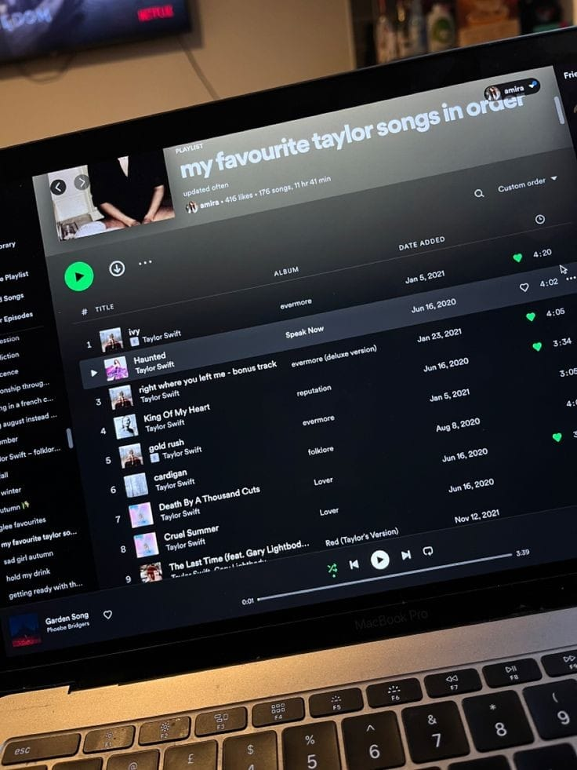
CONCLUSION:
Our Music Library focuses on playing songs...Further developments includes adding, updating or delete songs

